Slide 1
Food Delivery Demand Analysis Across Regions
Capstone Project – Presentation
NIIT Data Analytics with GenAI
Presented by :
Megh Malvankar.
Enrollment ID :
EN12026093826
Guide/Mentor :
Sir, Ashish Rajput.

Slide 2
Project Overview
Introduction
The Food Delivery Demand Analysis project aims to analyze customer orders, restaurant performance, delivery operations, and regional demand to generate meaningful business insights.
The project applies business analytics techniques using Excel, SQL, Python, Power BI, statistical analysis, and machine learning to support data-driven decision-making.
Datasets Used
Customers
Orders
Restaurants
Delivery Partners

Slide 3
Dataset-Information
Datasets | Columns | Records
Customers.xlsx | Customer_ID, Gender, Age_Group, Region, Customer_Type, Total_Orders, Average_Spend, Preferred_Cuisine | 22,000
Restaurants.xlsx | Restaurant_ID, Restaurant_Name, Cuisine_Type, Region, Avg_Preparation_Time_Minutes, Avg_Rating, Order_Capacity_Per_Day | 550
Delivery_Partners.xlsx | Delivery_Partner_ID, Partner_Name, Vehicle_Type, Avg_Delivery_Speed_KMPH, Successful_Deliveries, Delayed_Deliveries, Avg_Customer_Rating, Region, Delivery_Efficiency_Score | 1,100
Orders.xlsx | Order_ID, Order_Date, Customer_ID, Restaurant_ID, Region, Delivery_Partner_ID, Order_Value, Delivery_Fee, Discount_Applied, Final_Amount, Payment_Mode, Order_Status, Delivery_Time_Minutes, Order_Rating, Festival_Flag | 94,550

Slide 4
Objective Overview
Objective | Objective Title | Tasks | Tools Used
1 | Regional Demand & Business Performance Analysis | Task 1: Organize regional business information. Task 2: Summarize key business performance indicators. Task 3: Compare customer and regional performance. Task 4: Present trends using charts. Task 5: Create an interactive business dashboard. | Microsoft Excel
2 | Business Data Management & Query Analysis | Task 1: Create the business database. Task 2: Organize business information into tables. Task 3: Connect related business records. Task 4: Retrieve business information through queries. Task 5: Analyze operational performance using business reports. | MySQL
3 | Customer, Restaurant & Delivery Performance Analysis | Task 1: Prepare business data for analysis. Task 2: Validate and understand the available information. Task 3: Combine business datasets into a unified view. Task 4: Discover business trends and patterns. Task 5: Present findings using charts and business insights. Task 6: Summarize analytical findings for decision-making. | Python, Pandas, NumPy, Matplotlib
4 | Interactive Business Intelligence Dashboard | Task 1: Import business datasets. Task 2: Connect related business information. Task 3: Develop key business performance measures. Task 4: Build an interactive management dashboard. Task 5: Present business insights for monitoring performance. | Power BI, Power Query, DAX
5 | Predictive Analytics & Statistical Evaluation | Task 1: Prepare business data for prediction. Task 2: Perform statistical evaluation of business information. Task 3: Select important business factors for prediction. Task 4: Develop and compare predictive models. Task 5: Evaluate model performance and summarize business recommendations. | Python, Scikit-learn, SciPy

Slide 5
Project Flow Diagram
Food Delivery Datasets (Customers, Orders, Restaurants, Delivery Partners)
Objective 1
Excel Analysis
• Cleaning
• Pivot Tables
• KPIs
• Dashboard
Objective 2
SQL Analysis
• Database
• SQL Queries
• Joins
• Business Analysis
Objective 3
Python & EDA
• Validation
• Merge
• EDA
• Charts
• Insights
Objective 4
Power BI
• Modeling
• DAX
• Dashboard
• Insights
Objective 5 Machine Learning & Statistical Analysis
• Statistics
• Feature Engineering
• ML Models
• Evaluation

Slide 6
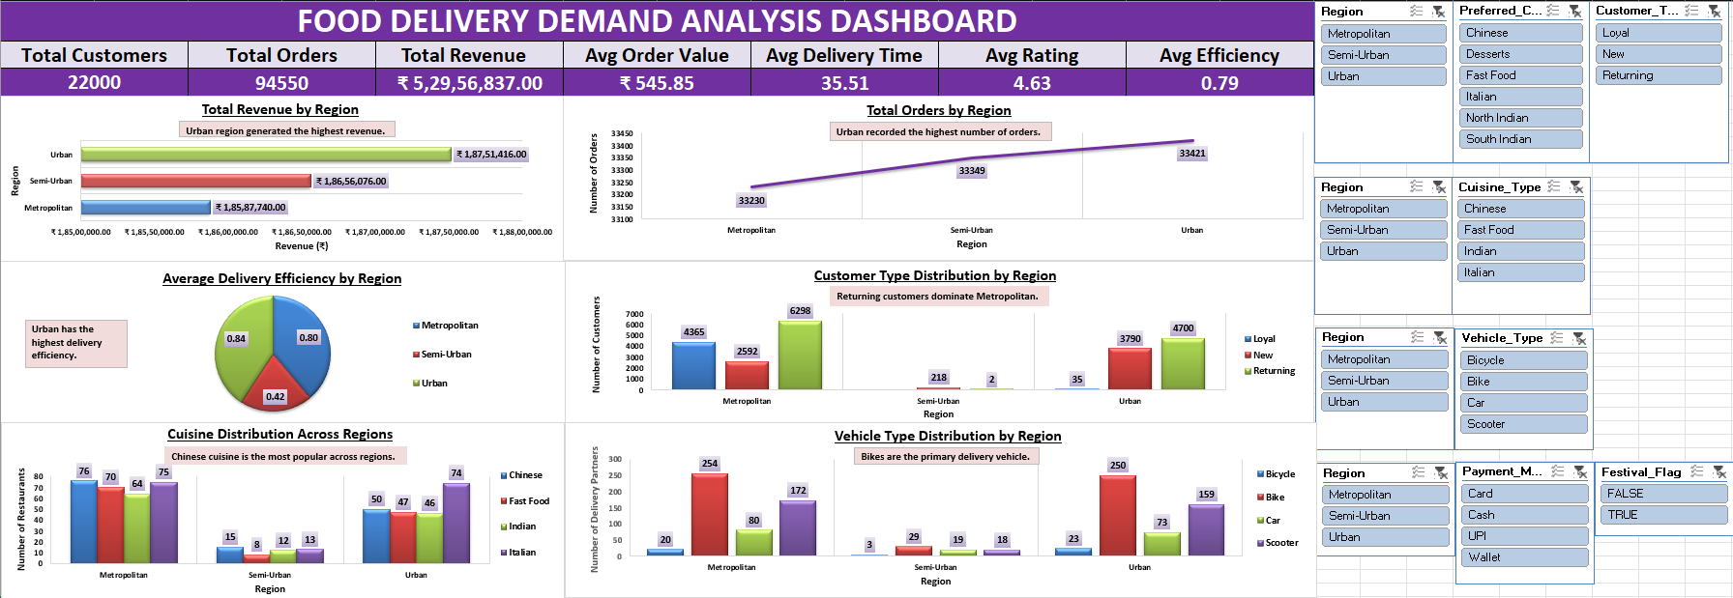
Objective 1 : Regional Demand & Business Performance Analysis
Fig : Food Delivery Demand Analysis Dashboard

Slide 7
Objective 1 : Conclusion
🔹 Key Insights
94,550 total orders analyzed across all regions.
Urban region generated the highest total revenue.
Urban region recorded the maximum number of customer orders.
Chinese cuisine emerged as the most preferred cuisine.
Urban region achieved the highest average customer rating.
Urban region recorded the highest delivery efficiency.
🔹 Tools Used
Microsoft Excel
Pivot Tables
Pivot Charts
KPI Cards
Slicers
🔹 KPIs
Total Customers
Total Orders
Total Revenue
Average Order Value
Average Delivery Time
Average Customer Rating
Average Delivery Efficiency
🔹 Business Outcome
The Excel dashboard provides a clear view of regional demand, customer behavior, restaurant performance, and delivery operations, supporting faster and data-driven business decisions.

Slide 8
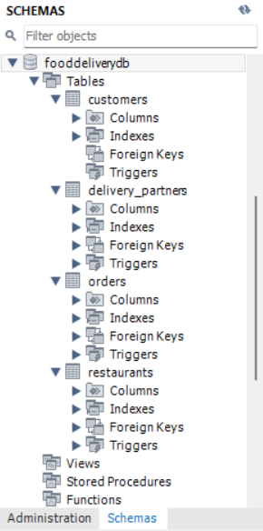
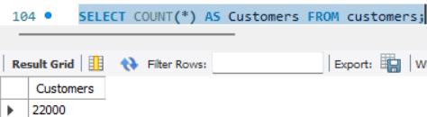
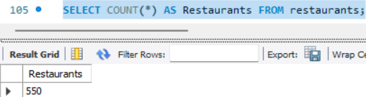
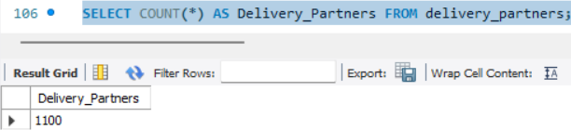
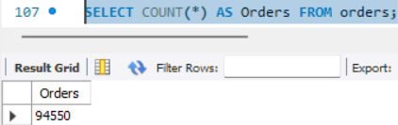
Objective 2 : Business Data Management & Query Analysis
Database Setup
Data Import Verification
Total Customers
Total Restaurants
Total Delivery Partners
Total Orders

Slide 9
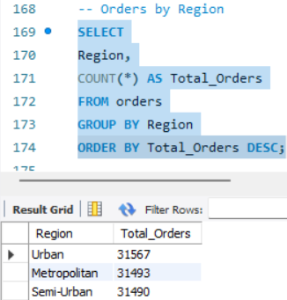
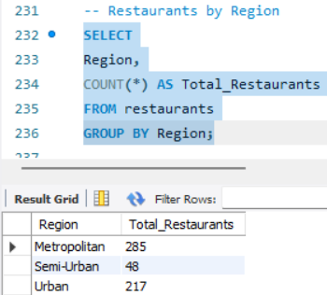
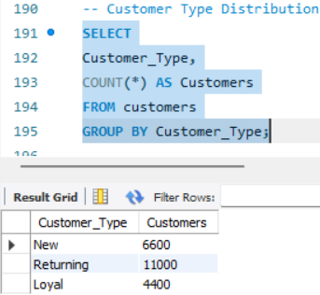
Objective 2 : Business Data Management & Query Analysis
Task 1 : Analyze Business Information Using SQL Queries.
Customer Type Distribution
Orders by Region
Restaurants by Region
Interpretation
Compared total customer orders across different regions.
Identified regions with the highest customer demand.
Interpretation
Analyzed the distribution of customer segments.
Identified the largest customer group for business planning.
Interpretation
Compared the number of restaurants available in each region.
Evaluated restaurant availability across different markets.

Slide 10
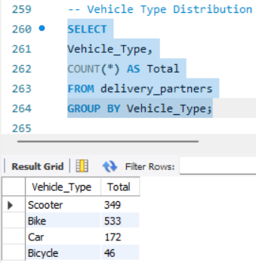
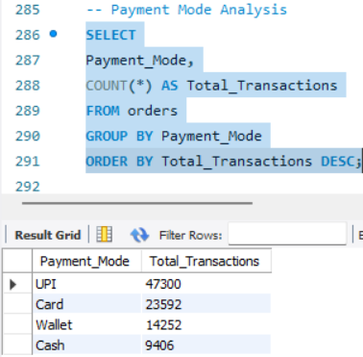
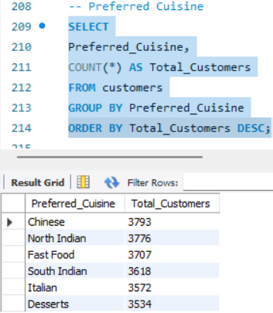
Objective 2 : Business Data Management & Query Analysis
Task 1 : Analyze Business Information Using SQL Queries.
Preferred Cuisine
Vehicle Type Distribution
Payment Mode Analysis
Interpretation
Compared delivery partners based on vehicle type.
Identified the most frequently used delivery vehicle.
Interpretation
Compared customer preferences across different cuisines.
Identified the most popular cuisine among customers.
Interpretation
Analyzed customer payment preferences.
Identified the most frequently used payment method.

Slide 11
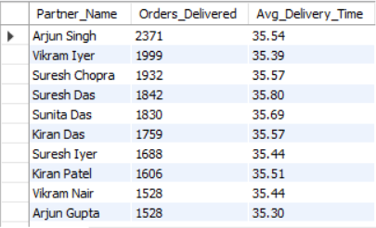
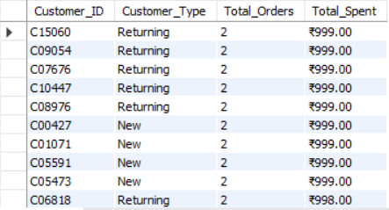
Objective 2 : Business Data Management & Query Analysis
Task 2 : Generate Business Performance Reports Using JOIN Operations.
Delivery Partner Performance (JOIN)
Customer Spending Analysis (JOIN)
Interpretation
Combined delivery partner and order information using SQL JOIN.
Evaluated delivery performance based on completed orders and delivery time.
Interpretation
Combined customer and order information using SQL JOIN.
Identified customer spending patterns and purchasing behaviour.

Slide 12
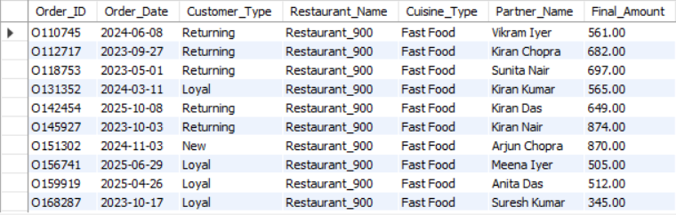
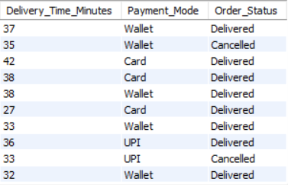
Objective 2 : Business Data Management & Query Analysis
Task 3 : Generate Integrated Business Report.
Complete Business Report (4-Table JOIN)
Interpretation
Integrated customer, restaurant, order, and delivery data into a single report.
Generated a unified business view to support operational analysis and decision-making.

Slide 13
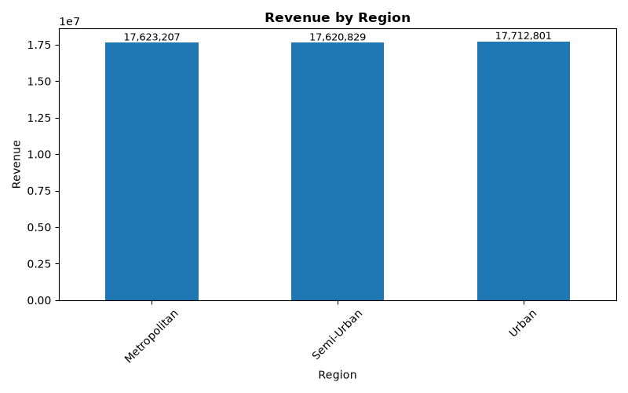

Objective 3 : Customer, Restaurant & Delivery Performance Analysis
Task 1 : Discover Business Trends and Patterns
Interpretation
Revenue by Region
Compared revenue generated across different regions.
Identified the highest revenue-generating region.
Interpretation
Orders by Region
Compared customer order volume across regions.
Identified the region with the highest customer demand.

Slide 14
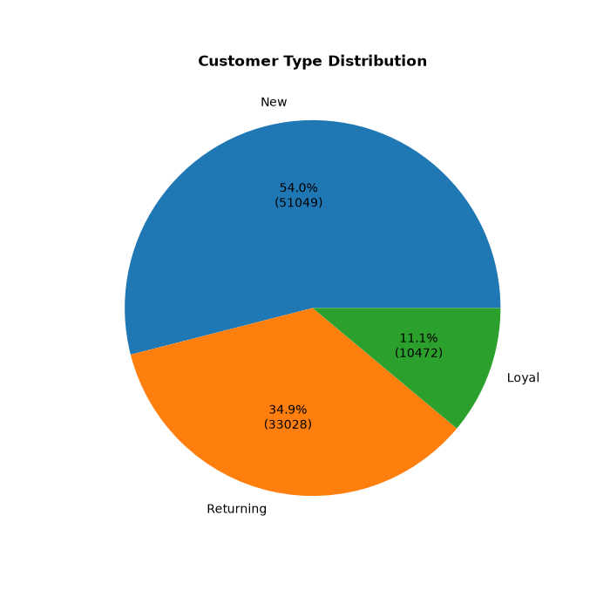
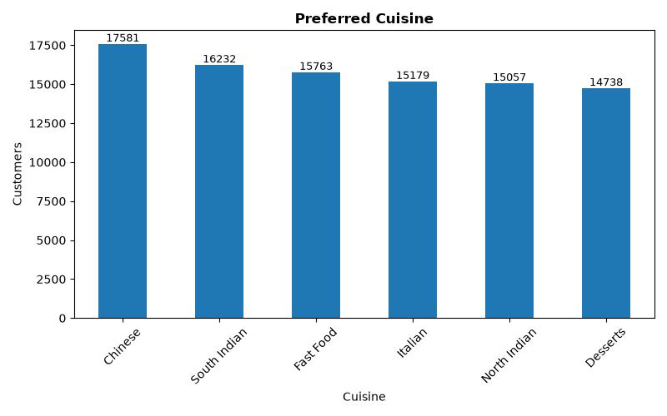
Objective 3 : Customer, Restaurant & Delivery Performance Analysis
Task 2 : Present Findings Using Data Visualizations
Interpretation
Customer Type Distribution
Compared different customer segments.
Identified the dominant customer category.
Interpretation
Preferred Cuisine
Analyzed customer cuisine preferences.
Identified the most popular cuisine.

Slide 15
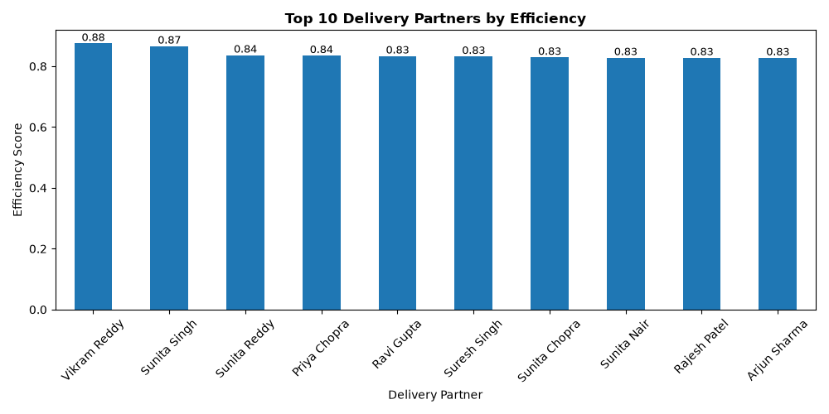
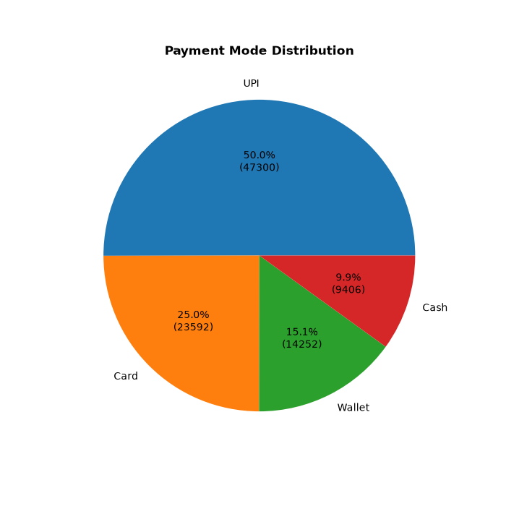
Objective 3 : Customer, Restaurant & Delivery Performance Analysis
Task 3 : Business Insights & Decision Support
Interpretation
Delivery Efficiency
Compared delivery partner performance using efficiency scores.
Identified the highest-performing delivery partners.
Interpretation
Payment Mode Distribution
Compared customer payment preferences.
Identified the most frequently used payment method.

Slide 16
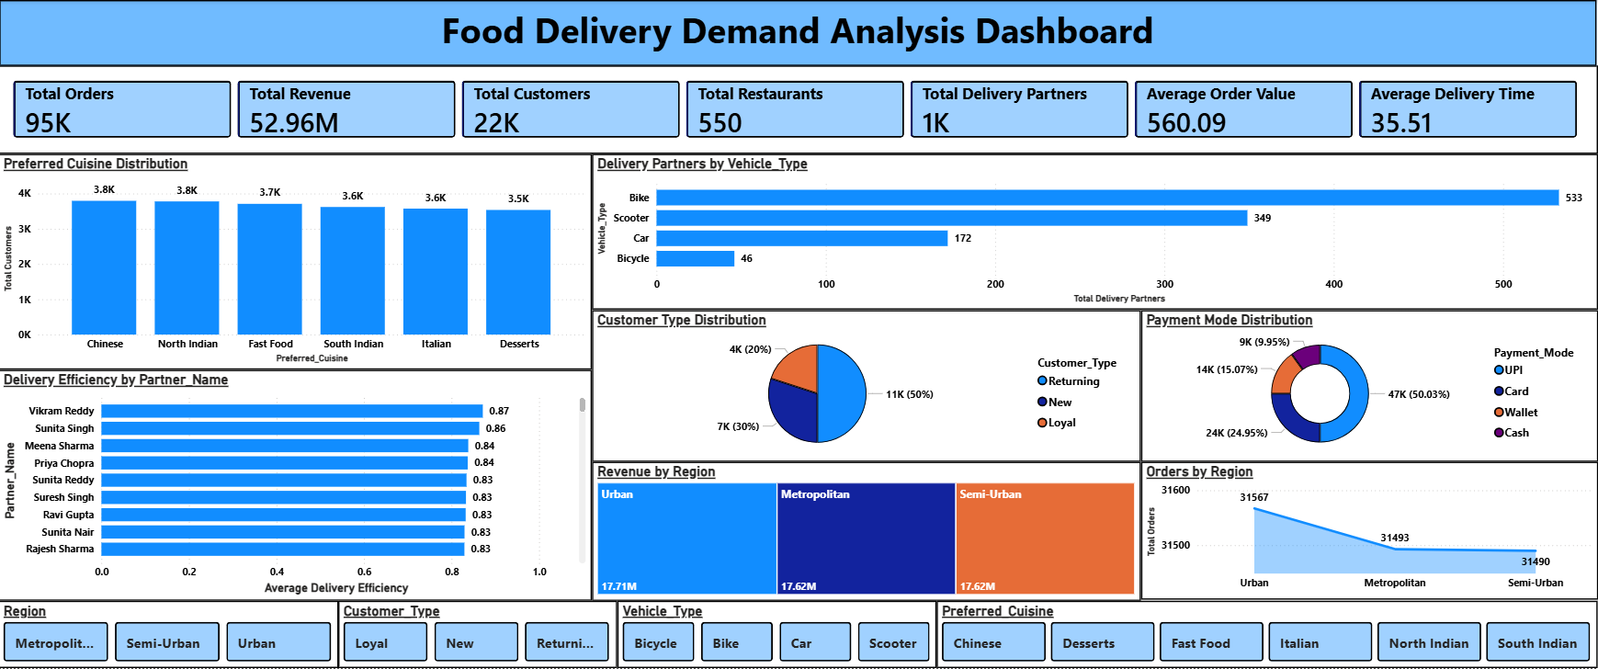
Objective 4 : Interactive Business Intelligence Dashboard
Fig : Food Delivery Demand Analysis PowerBI Dashboard

Slide 17
Objective 4 : Conclusion
Key Insights
Analyzed 95K orders with an interactive Power BI dashboard.
Generated 52.96M in total revenue from 22K customers, 550 restaurants, and 1K delivery partners.
Chinese cuisine was the most popular, while UPI accounted for nearly 50% of payments.
Urban regions recorded the highest revenue (17.71M) and 31.6K orders.
Bike was the primary delivery mode, with an average delivery time of 35.5 minutes.
🔹 Business Outcome
The dashboard consolidates sales, customers, restaurants, deliveries, and payment insights into a single interactive view, enabling faster performance tracking and data-driven decision-making.

Slide 18
Objective 5 : Predictive Analytics & Statistical Evaluation
Category | Analysis | Business Objective | Result | Business Interpretation
Statistical Analysis | Descriptive Statistics | Summarize business data | 94,550 records analyzed | Dataset is complete and suitable for analysis.
Statistical Analysis | Correlation Analysis | Measure relationships among variables | Correlation Matrix Generated | Most business variables showed weak to moderate relationships.
Statistical Analysis | Revenue by Customer Type | Compare customer spending | Returning: 560.83, New: 559.75, Loyal: 559.45 | Customer spending is nearly consistent across all customer types.
Statistical Analysis | Delivery Time by Region | Compare regional delivery performance | Metro: 35.50, Semi-Urban: 35.51, Urban: 35.51 | Delivery performance remains consistent across regions.
Statistical Analysis | Independent t-Test | Compare Loyal vs New customer spending | p = 0.8736 | No statistically significant difference was found.

Slide 19
Objective 5 : Conclusion
Category | Model | Business Objective | Result | Business Interpretation
Machine Learning | Linear Regression | Predict customer order ratings | MAE = 0.6429, R² = −0.0005 | Lower prediction error among the evaluated models.
Machine Learning | Random Forest | Correlation Matrix Generated | MAE = 0.7683, R² = −0.1794 | Lower predictive performance than Linear Regression.
Machine Learning | Best Model | Compare model performance | Linear Regression | Selected as the best-performing model for this dataset.
Key Business Outcomes :
Analyzed 94,550 business records using statistical analysis and machine learning.
Verified a clean dataset with no missing values or duplicate records.
Identified consistent customer spending and delivery performance across customer types and regions.
Linear Regression outperformed Random Forest and was selected as the best predictive model.
Successfully completed an end-to-end analytics workflow, from data preparation and statistical analysis to machine learning and model evaluation.

Slide 20
Project Summary
Developed a complete Food Delivery Demand Analysis solution by integrating customer, order, restaurant, and delivery partner data to understand overall business performance.
Performed data analysis using Excel, SQL, Python, and Power BI to identify business trends, measure operational performance, and build interactive dashboards for decision-making.
Applied statistical analysis and machine learning techniques to validate business insights, evaluate customer behavior, and compare predictive models for business decision support.
Generated actionable business recommendations to improve regional performance, customer satisfaction, delivery efficiency, and support data-driven strategic planning.

Slide 21
Conclusion
Successfully integrated Excel, SQL, Python, Power BI, and Machine Learning to perform end-to-end analysis of the food delivery business.
Identified key business insights related to customer behavior, regional demand, restaurant performance, revenue, and delivery operations through comprehensive data analysis.
Validated analytical findings using statistical techniques and predictive models, supporting reliable and data-driven business decisions.
Delivered practical recommendations to improve operational efficiency, customer satisfaction, and overall business performance, demonstrating the value of data analytics in solving real-world business problems.

Slide 22
THANK YOU

